Slide 2
Unmasked
Proverbs 28:13-14

Slide 3
Proverbs 28
13 Whoever conceals his transgressions will not prosper, but he who confesses and forsakes them will obtain mercy.

Slide 4
Proverbs 28
14 Blessed is the one who fears the LORD always, but whoever hardens his heart will fall into calamity.

Slide 5
Unmasked
13 Whoever conceals his transgressions
will not prosper,
HIDING
__________ is not a long term solution

Slide 6
Unmasked
but he who confesses and forsakes
them will obtain mercy.
REVEALING
______________ opens the door to mercy

Slide 7
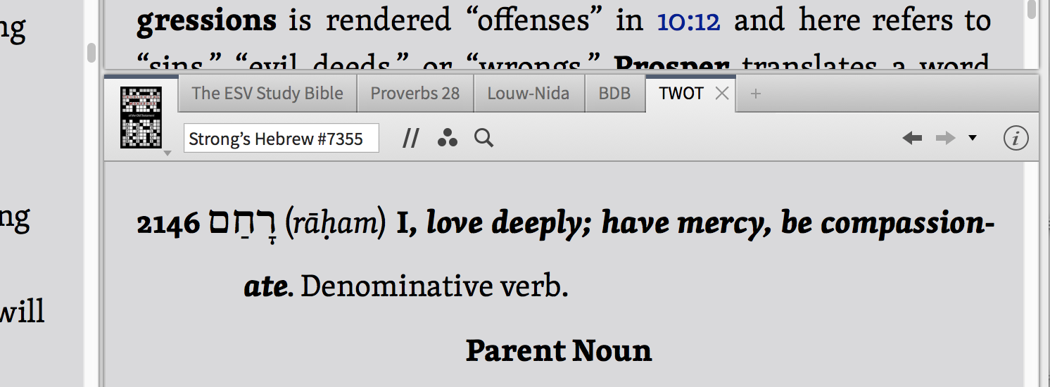

Slide 8
Unmasked
14 Blessed is the one who
fears the LORD always,
but whoever hardens his heart
will fall into calamity.
RELATING
Rightly ______________ to God is key

